Slide 1
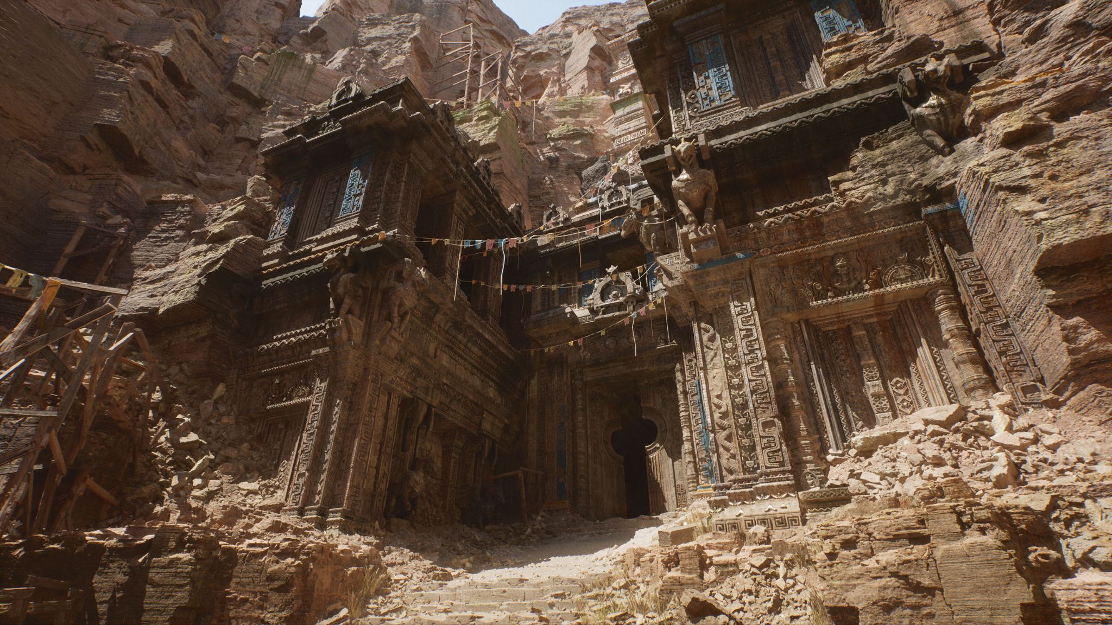
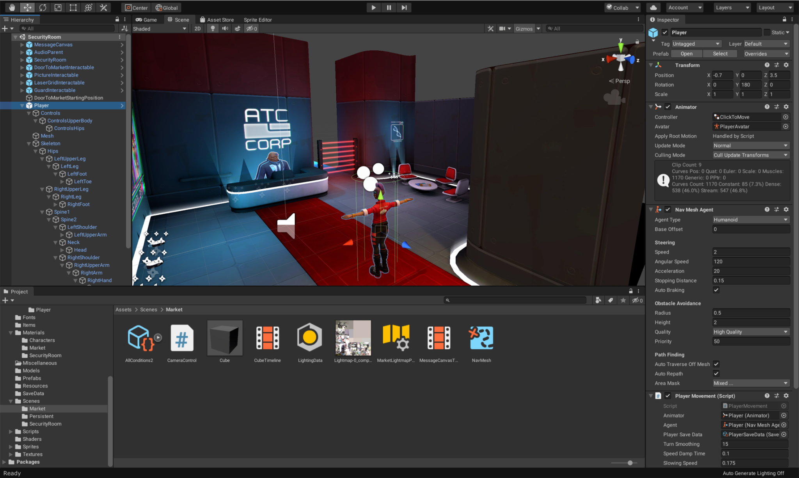
Lesson 2
Basis
Nicolas Serf
serf.nicolas@gmail.com

Slide 2

Basis game development

Slide 3

Basis game development
Assets

Slide 4
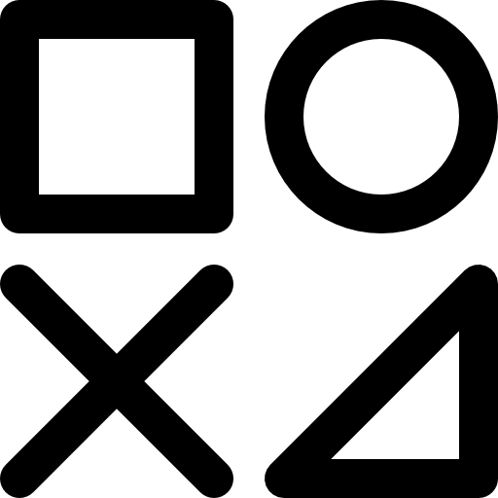

Type
Basis
Basis game development
Definition
1. Asset
An asset is the basis of every game engine and every project. These are the elements you’ll find in your explorer and constitute your project. A script, a texture, an image, etc… all of this are assets
2. World
3. Object
4. Details
Content
5. Finder
Assets is the content of your game. Everything is asset and when it comes to cooking, engine will be using the assets in your project to be packaged into the executable.
6. Console
7. Template
Import
Some assets will be created from the engine, some will be imported. For most cases, you can simply drag & drop a file from windows’s explorer into engine explorer to import it.

Slide 5
Basis
Type
Basis game development
Definition
1. Asset
Type of assets depends on the engine you’re using but the idea is that every asset has a type which goes from image type (jpg, png, etc…) to sound type (Wav, mp3, etc…)
2. World
3. Object
4. Details
Transformation
5. Finder
It is also important to notice that an asset is not mandatory of the type from which you imported. There is some format that are proprietary, or not suits to the engine, which convert them into an internal format
6. Console
7. Template

Slide 6

Editor
World

Slide 7
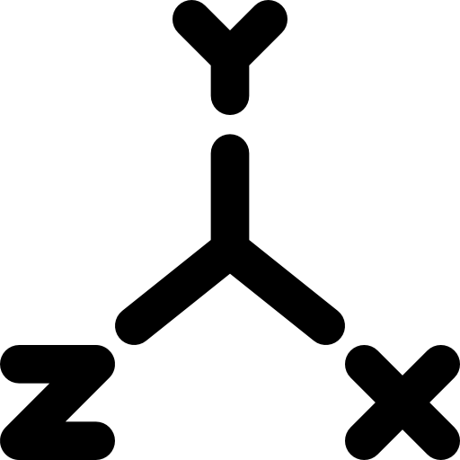




Coordinate
Design
Widget
Level
Basis game development
Options
Definition
1. Asset
A world is composed of multiples levels. The name can vary but the principle is exactly the same. A level is where the level designers will be working to create a place where the player will interact and play
2. World
3. Object
4. Details
Asset
5. Finder
A level is an asset, like everything, and it will contains all information about every object you’ve placed in it.
6. Console
7. Template
Transition
Levels are the main elements when it comes to loading a map, having a loading screen, etc…

Slide 8
Level
Design
Widget
Coordinate
Basis game development
Options
Definition
1. Asset
Coordinate is not a concept tied to world directly, but is central to it. A location will always be related to the world 0, 0, 0. The world offers the coordinate system and reference point for every objects
2. World
3. Object
4. Details
Left hand vs right hand
5. Finder
This is something you really need to take care. Some engine take left hand as coordinate when others take right hand. It leads to having a X axis inverted between forward and backward
6. Console
7. Template
Y vs Z up vector
Also important, we are used to Y being the upper vector because of 2D, but for most game engine, Z is the upper vector will Y is the left vector

Slide 9
Level
Coordinate
Widget
Design
Basis game development
Options
Definition
1. Asset
World is what manage the levels underneath when you are loading levels, you are actually adding a level into the world. The design process has to take that into consideration because multiple level can layer.
2. World
3. Object
4. Details
Artistic task
5. Finder
Designing a level is an artistic task, and developers are usually not involved but you must be aware of world design feature like for example world partition on UE
6. Console
7. Template

Slide 10
Level
Coordinate
Design
Widget
Basis game development
Options
Definition
1. Asset
When you are designing levels within the world, you have access to a variety of widgets that offers options to modify the object like moving, scaling, rotating for the most common one.
2. World
3. Object
4. Details
Others
5. Finder
Transform widget is not the only one and this will be dependant on the engine, but you can for example find grid size, rotation scale, snapping, gizmos, etc…
6. Console
7. Template

Slide 11
Level
Coordinate
Design
Options
Editor
Widget
Definition
1. Asset
When you’re working in the world, engines also offers various options to alter the looks of the scene. Like showing the depth, a wireframe view, showing navmesh, changing resolution, etc…
2. World
3. Object
4. Details
5. Finder
6. Console
7. Template

Slide 12
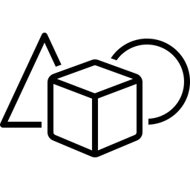
Editor
Object

Slide 13
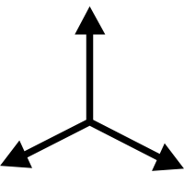

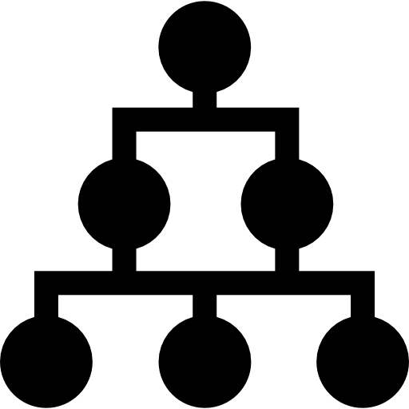


Transform
Container
Hierarchy
Entity
What is a game engine ?
Component
Definition
1. Asset
Object have different names based on engine : Gameobject, actor, etc… but the concept stays the same. They are objects which will be placeable into a level.
2. World
3. Object
4. Details
An empty box
5. Finder
You’ll understand it in the next slides, but an object is basically an empty box with a transform, on which you’ll be connecting a lot of things in order to give functionalities
6. Console
7. Template

Slide 14

Entity
Container
Hierarchy
Transform
What is a game engine ?
XXX
Definition
1. Asset
If objects are placeable, it means they have a transform. A transform is a set of 3 property : Location, Rotation and Scale.
Location is a vector3 representing x,y,z position in the world
Rotation is a vector3 representing Pitch, yaw, Roll in the world
Scale is a vector3 representing x,y,z scaling on axis in the world
2. World
3. Object
4. Details
5. Finder
6. Console
7. Template
World vs local
Related to hierarchy, local transform shouldn’t be confused with world transform. A local transform will always be relative to parent, while world transform will be relative to world 0, 0, 0.

Slide 15
Entity
Transform
Hierarchy
Container
What is a game engine ?
Component
Definition
1. Asset
As explained a bit earlier, an object by itself is nothing but an empty thing in a level. It comes to life when you bring element to it.
2. World
3. Object
4. Details
Example
5. Finder
There is as many element that you can add, as your imagination comes with. Anything can be added to an object, a mesh to have a representation, a sound player to have sound, etc…
6. Console
7. Template

Slide 16
Entity
Transform
Container
Hierarchy
What is a game engine ?
Component
Definition
1. Asset
Another really important point about objects is the hierarchy system. Every object is a child of another. This hierarchy explains the local / world difference and have also some implication
2. World
3. Object
4. Details
Root
5. Finder
A level must be seen as a graph, and for any graph there is a root. This means top level object in a level are actually child of the root of the level, which is invisible in the editor.
6. Console
7. Template
Implication
When an object is moving, rotating or moving, it will directly affect the children because of natural hierarchy inheritance of transform property. Thankfully, there is a way to avoid that in every engine.

Slide 17
Entity
Transform
Container
Component
What is a game engine ?
Hierarchy
Definition
1. Asset
A component is basically an encapsulated logic which can be connected to an object in order to gives it new functionalities. There is graphical component and logical component.
2. World
3. Object
4. Details
Engine’s components
5. Finder
Every engine comes with a set of component already defined and implemented. Takes for example a mesh, a skeletal mesh, an audio player, etc… All of this are components provided by engine.
6. Console
7. Template
Custom components
There is multiple ways to develops new features, one is to bring a new feature through a component. Imagine an inventory, if you want our actor to have an inventory, simply add that component

Slide 18

Editor
Details

Slide 19



Properties
Customization
Selection
What is a game engine ?
Definition
1. Asset
Details allows to have more information about something as the name suggests. In engine, when you select an entity in the world, the details panel will update with the informations of that object
2. World
3. Object
4. Details
Multi-selection
5. Finder
Multi-selection is a thing in some engine When you are selecting entities of same type, or containing same components, you may be able to edit multiples instance’s properties at the same time
6. Console
7. Template

Slide 20
selection
Customization
Properties
What is a game engine ?
Definition
1. Asset
A property is anything contains within the entity. It will differ based on which engine you use, but the logic stays the same. Features you develop exposes some properties that designers will tweak.
2. World
3. Object
4. Details
Exposing
5. Finder
It is developer’s job to expose some key variables of the feature to be tweakable. They will appears in the detail panel when you select the entity / component.
6. Console
7. Template
Runtime
Changing properties at runtime may be something you want to maintains for designers to easily tweaks properties to try things, but it is not always as straightforward as that if there is side effects

Slide 21
Properties
Selection
Customization
What is a game engine ?
Definition
1. Asset
You can customize display of properties in the details. It can be more or less difficult, based on the engine and the tools they offers but it is always possible.
2. World
3. Object
4. Details
The good, the bad, the ugly
5. Finder
Doing editor modification should always be considered with care, because you may completely messed-up things. But when used properly, it is a powerful way to increase productivity.
6. Console
7. Template
Tab creation
You can even create complete new tab window to be used in the editor, but it will not be covered in this lesson.

Slide 22

Editor
Finder

Slide 23


Filters
Creation
Assets
What is a game engine ?
Definition
1. Asset
Finder is like a windows explorer, but specific to your project location. it is the place where every assets is located.
2. World
3. Object
4. Details
Root
5. Finder
There is always a root folder, which is something not shown, but every assets needs to be located in it. The assets here will be translated into comprehensive format for engine, and able to be cooked
6. Console
7. Template
Moving stuff
When you move stuff in and out of content folder, be careful to do it from engine, and never from windows explorer. You may messed-up things, because engine will not transform the assets sometimes.

Slide 24
Assets
Creation
Filters
What is a game engine ?
Definition
1. Asset
Every finders comes with a filter feature that allows to show only some type of assets, or filter by name, etc…
2. World
3. Object
4. Details
Implication
5. Finder
This is specific to project and companies, but having a filter options can be impacting how you architecture the file folder.
6. Console
7. Template

Slide 25
Filters
Assets
Creation
What is a game engine ?
Definition
1. Asset
Obviously, being the location of assets, finder will offer the possibility to create assets from it. You’ll most likely have to right click in it, and choose the type of asset you want to create.
2. World
3. Object
4. Details
Naming convention
5. Finder
Naming convention is really important to stay organized regarding file hierarchy. If you choose to start every material with M_, be sure to stick with that rule in the entire project.
6. Console
7. Template

Slide 26

Editor
Console

Slide 27


Logging
Debug
What is a game engine ?
Definition
1. Asset
Every engine comes with a console that allows to see debug message, errors, warning, etc… That’s the primary tool, with breakpoint, that’ll allows to track issues
2. World
3. Object
4. Details
Warning
5. Finder
Whatever engine you use, do not ignore warning, in the short term, they could be nothing but in the long run, they may be issue regarding performance, unknown bug, etc…
6. Console
7. Template

Slide 28
Debug
Logging
What is a game engine ?
Definition
1. Asset
Logging process is primordial for development. it is what fills debug console with messages. You’ll most likely log with a category, and some log are generated by the engine when an error occurred.
2. World
3. Object
4. Details
Creation
5. Finder
It will depends of the engine used, but most of them allows to create new logging categories, either from visual or code side. it will allows to develop features independent with a proper logging category.
6. Console
7. Template
Filters
When it comes to filtering, error, warning, info are some categories that are common to every engine. But given you can create new logging category, you may be able to filter with the custom categories

Slide 29

Editor
Template

Slide 30


Operation
Instances
Pattern
What is a game engine ?
Definition
1. Asset
A pattern is like the name suggest, something that will be similar and followed by everything that starts from it.
2. World
3. Object
4. Details
Cake example
5. Finder
Take a cake as an example. You’ll be using a mould to make the foundations. Then, you can decorate the cake as you liked, they may all be different in the end, but with a common base, immutable for all.
6. Console
7. Template

Slide 31
Pattern
Instances
Operation
What is a game engine ?
Definition
1. Asset
The operation made by a template is quite simple, making sure that every instance coming from that template is up to date with the template;
2. World
3. Object
4. Details
Inheritance logic
5. Finder
You can take in comparison standard inheritance of class system. When you do a modification, it is implicitly affecting child class. Template have the same logic.
6. Console
7. Template
Overridden properties
When you modify some properties (like position, a variable in a component, etc…) of a template, it may not affect children if they have modifies that property. Children have priority in that case.

Slide 32
Pattern
Operation
Instances
What is a game engine ?
Definition
1. Asset
An instance is a template which is placed into the world, on which you’ll be able to modify properties, and which will be affected by changes.
2. World
3. Object
4. Details
Instance vs child
5. Finder
A child of a template still remains a template, you can create a hierarchy of template, one being more specific from the higher one, but it is still not an instance. THe difference is
6. Console
7. Template

Slide 33

Unity

Slide 34
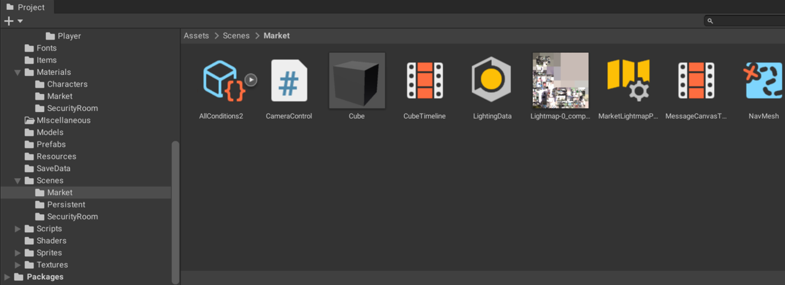
Edition
Unity
Asset & Finder

Slide 35
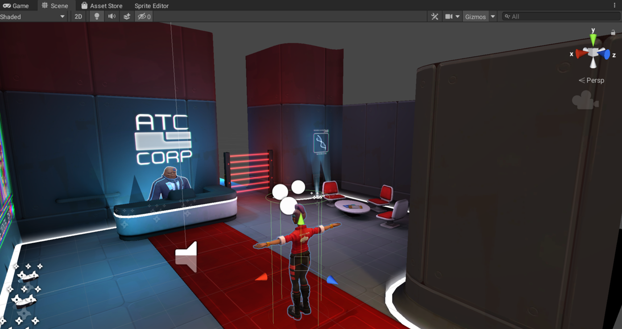
Edition
Unity
World

Slide 36
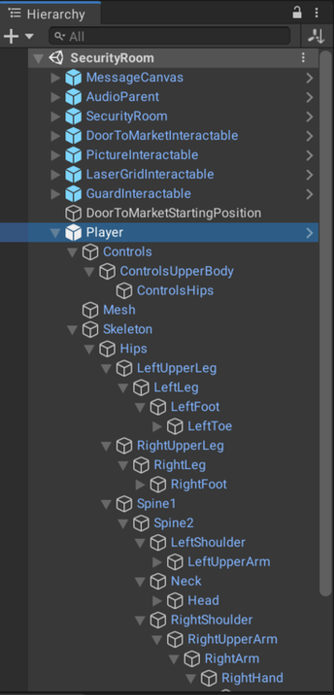
Edition
Unity
Object

Slide 37
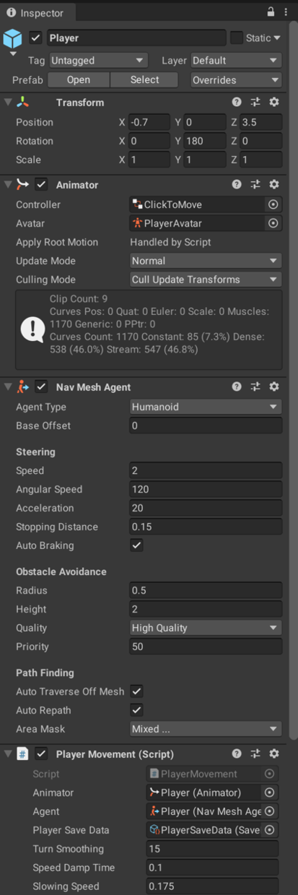
Edition
Unity
Details

Slide 38
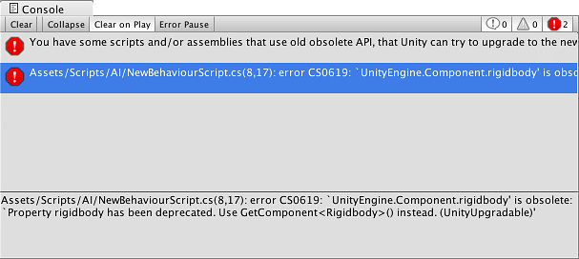
Edition
Unity
Console

Slide 39
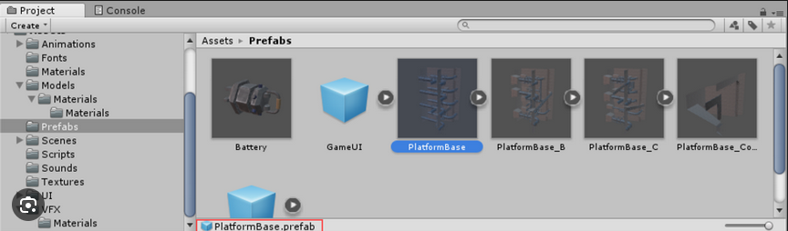
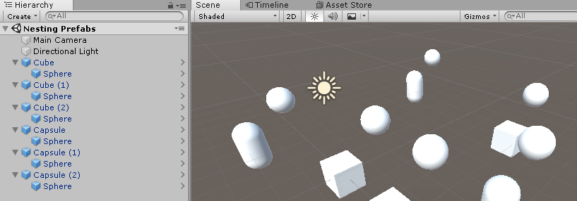
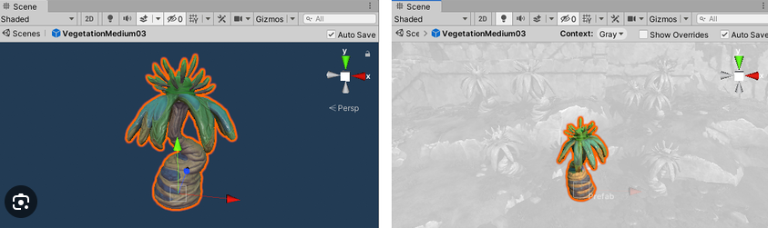
Edition
Unity
Template

Slide 40

Live demonstration

Slide 41

Questions ?

